Slide 1
DESIGNING A SET OF RELATIONS (2)
Goals:
Lossless join property (a must)
.
Dependency preservation property
Additional normal forms
4NF (based on multi-valued dependencies)
5NF (based on join dependencies)

Slide 2
1. Properties of Relational Decompositions (1)
Relation Decomposition and Insufficiency of Normal Forms:
Universal Relation Schema:
A relation schema R = {A1, A2, …, An} that includes all the attributes of the database.
Universal relation assumption:
Every attribute name is unique.

Slide 3
Properties of Relational Decompositions (2)
Relation Decomposition and Insufficiency of Normal Forms (cont.):
Decomposition:
The process of decomposing the universal relation schema R into a set of relation schemas D = {R1,R2, …, Rm} that will become the relational database schema by using the functional dependencies.
Attribute preservation condition:
Each attribute in R will appear in at least one relation schema Ri in the decomposition so that no attributes are “lost”.

Slide 4
Properties of Relational Decompositions (2)
Another goal of decomposition is to have each individual relation Ri in the decomposition D be in BCNF or 3NF.
Additional properties of decomposition are needed to prevent from generating spurious tuples

Slide 5
Properties of Relational Decompositions (3)
Dependency Preservation Property of a Decomposition:
Definition: Given a set of dependencies F on R, the projection of F on R_{i}, denoted by p_{Ri}(F) where R_{i} is a subset of R, is the set of dependencies X  Y in F⁺ such that the attributes in X υ Y are all contained in R_{i}.
Hence, the projection of F on each relation schema R_{i} in the decomposition D is the set of functional dependencies in F⁺, the closure of F, such that all their left- and right-hand-side attributes are in R_{i}.

Slide 6
Properties of Relational Decompositions (4)
Dependency Preservation Property of a Decomposition (cont.):
Dependency Preservation Property:
A decomposition D = {R1, R2, ..., Rm} of R is dependency-preserving with respect to F if the union of the projections of F on each Ri in D is equivalent to F; that is ((π_{R1}(F)) υ . . . υ (π_{Rm}(F)))⁺ = F⁺
Claim 1:
It is always possible to find a dependency-preserving decomposition D with respect to F such that each relation Ri in D is in 3nf.

Slide 7
Properties of Relational Decompositions (5)
Lossless (Non-additive) Join Property of a Decomposition:
Definition: Lossless join property: a decomposition D = {R1, R2, ..., Rm} of R has the lossless (nonadditive) join property with respect to the set of dependencies F on R if, for every relation state r of R that satisfies F, the following holds, where * is the natural join of all the relations in D:
* (π _{R1}(r), ..., π_{Rm}(r)) = r
Note: The word loss in lossless refers to loss of information, not to loss of tuples. In fact, for “loss of information” a better term is “addition of spurious information”

Slide 8
Properties of Relational Decompositions (6)
Lossless (Non-additive) Join Property of a Decomposition (cont.):
Algorithm 11.1: Testing for Lossless Join Property
Input: A universal relation R, a decomposition D = {R1, R2, ..., Rm} of R, and a set F of functional dependencies.
1. Create an initial matrix S with one row i for each relation Ri in D, and one column j for each attribute Aj in R.
2. Set S(i,j):=bij for all matrix entries. (* each bij is a distinct symbol associated with indices (i,j) *).
3. For each row i representing relation schema Ri
{for each column j representing attribute Aj
{if (relation Ri includes attribute Aj) then set S(i,j):= aj;};};
(* each aj is a distinct symbol associated with index (j) *)
CONTINUED on NEXT SLIDE

Slide 9
Properties of Relational Decompositions (7)
4. Repeat the following loop until a complete loop execution results in no changes to S
{for each functional dependency X Y in F
{for all rows in S which have the same symbols in the columns corresponding to attributes in X
{make the symbols in each column that correspond to an attribute in Y be the same in all these rows as follows:
If any of the rows has an “a” symbol for the column, set the other rows to that same “a” symbol in the column.
If no “a” symbol exists for the attribute in any of the rows, choose one of the “b” symbols that appear in one of the rows for the attribute and set the other rows to that same “b” symbol in the column ;};
};
};
5. If a row is made up entirely of “a” symbols, then the decomposition has the lossless join property; otherwise it does not.

Slide 10
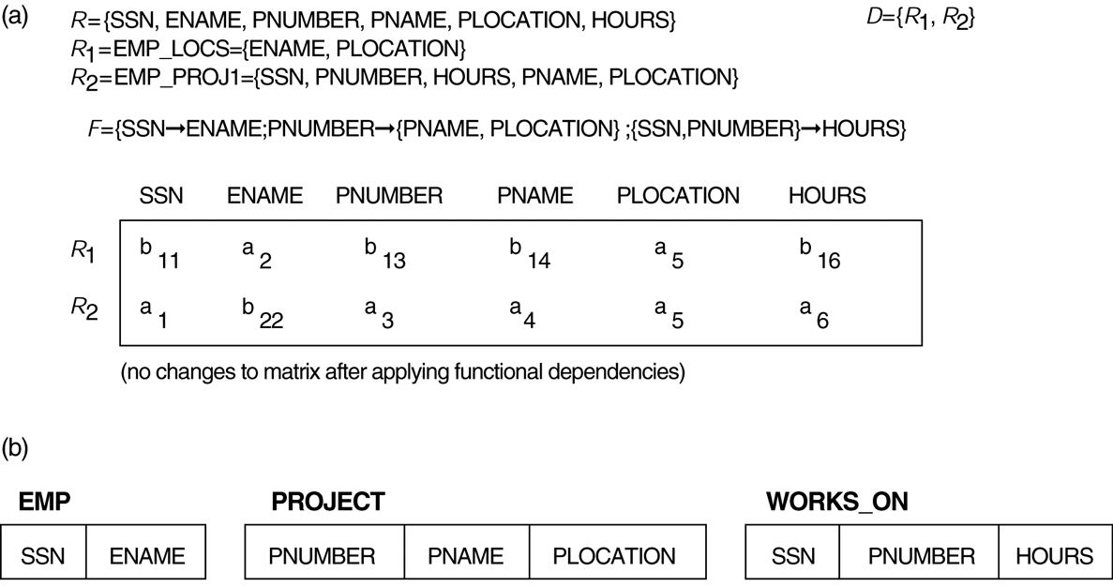
Properties of Relational Decompositions (8)
Lossless (nonadditive) join test for n-ary decompositions. (a) Case 1: Decomposition of EMP_PROJ into EMP_PROJ1 and EMP_LOCS fails test.
(b) A decomposition of EMP_PROJ that has the lossless join property.

Slide 11
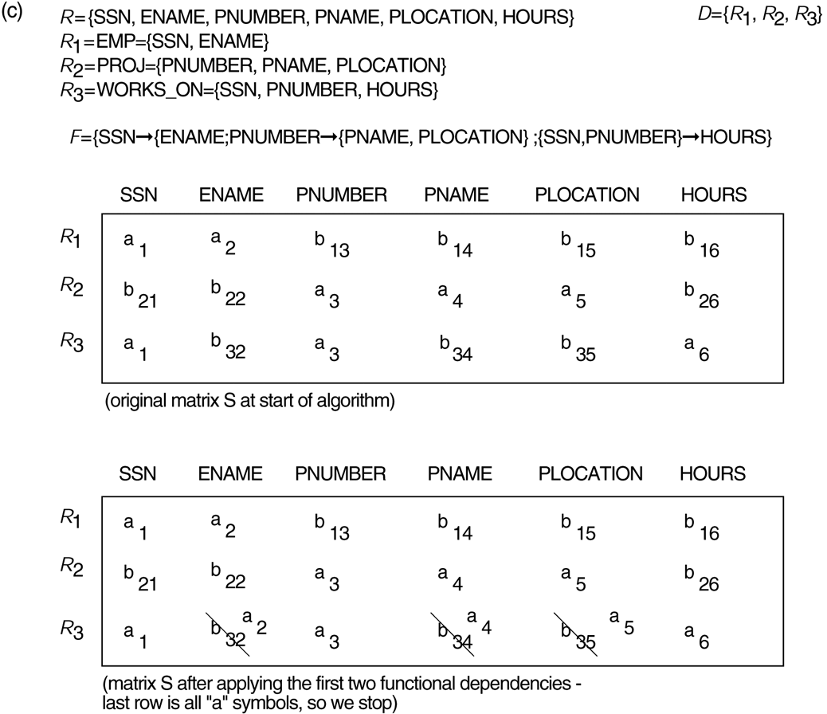
Properties of Relational Decompositions (8)
Lossless (nonadditive) join test for n-ary decompositions. (c) Case 2: Decomposition of EMP_PROJ into EMP, PROJECT, and WORKS_ON satisfies test.

Slide 12
Properties of Relational Decompositions (9)
Testing Binary Decompositions for Lossless Join Property
Binary Decomposition: Decomposition of a relation R into two relations.
PROPERTY LJ1 (lossless join test for binary decompositions): A decomposition D = {R1, R2} of R has the lossless join property with respect to a set of functional dependencies F on R if and only if either
The f.d. ((R1 ∩ R2)  (R1- R2)) is in F⁺, or
The f.d. ((R1 ∩ R2)  (R2 - R1)) is in F⁺.

Slide 13
Algorithms for Relational Database Schema Design (7)
Discussion of Normalization Algorithms:
Problems:
The database designer must first specify all the relevant functional dependencies among the database attributes.
These algorithms are not deterministic in general.
It is not always possible to find a decomposition into relation schemas that preserves dependencies and allows each relation schema in the decomposition to be in

Slide 14
Multivalued Dependencies and Fourth Normal Form (2)
Definition:
A multivalued dependency (MVD) X —>> Y specified on relation schema R, where X and Y are both subsets of R, specifies the following constraint on any relation state r of R: If two tuples t₁ and t₂ exist in r such that t₁[X] = t₂[X], then two tuples t₃ and t₄ should also exist in r with the following properties, where we use Z to denote (R - (X υ Y)):
t₃[X] = t₄[X] = t₁[X] = t₂[X].
t₃[Y] = t₁[Y] and t₄[Y] = t₂[Y].
t₃[Z] = t₂[Z] and t₄[Z] = t₁[Z].
An MVD X —>> Y in R is called a trivial MVD if (a) Y is a subset of X, or (b) X υ Y = R.

Slide 15
Multivalued Dependencies and Fourth Normal Form (4)
Definition:
A relation schema R is in 4NF with respect to a set of dependencies F (that includes functional dependencies and multivalued dependencies) if, for every nontrivial multivalued dependency X —>> Y in F⁺, X is a superkey for R.
Note: F⁺ is the (complete) set of all dependencies (functional or multivalued) that will hold in every relation state r of R that satisfies F. It is also called the closure of F.

Slide 16
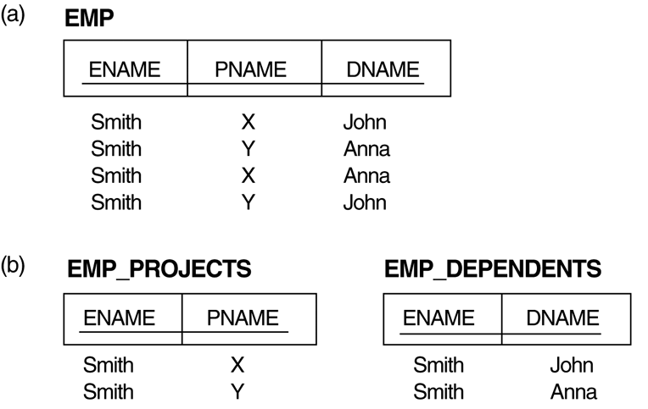
3. Multivalued Dependencies and Fourth Normal Form (1)
The EMP relation with two MVDs: ENAME —>> PNAME and ENAME —>> DNAME.
Decomposing the EMP relation into two 4NF relations EMP_PROJECTS and EMP_DEPENDENTS.

Slide 17
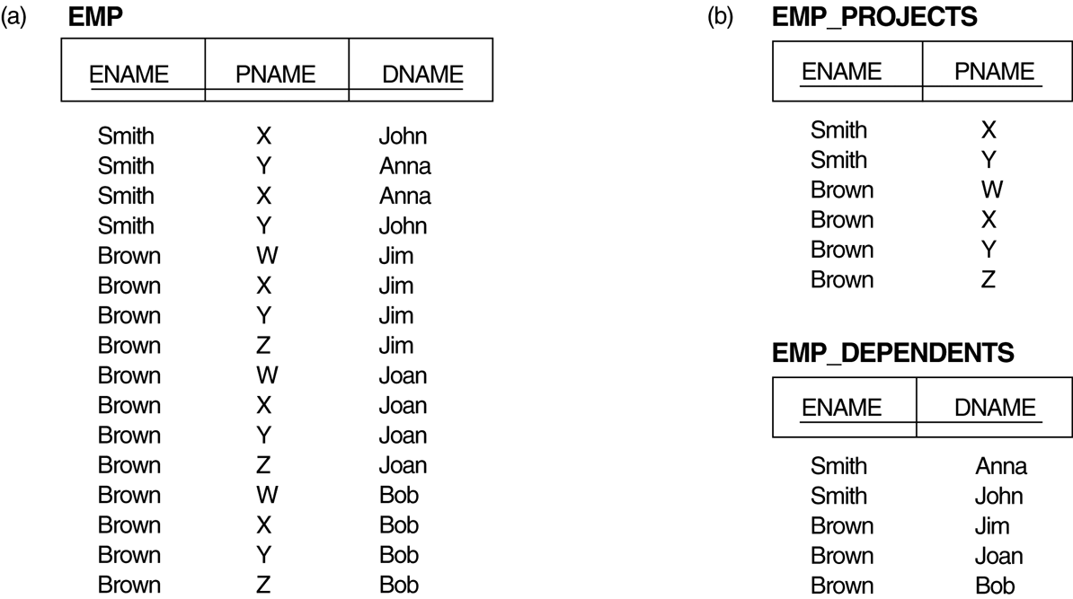
Multivalued Dependencies and Fourth Normal Form (5)
Decomposing a relation state of EMP that is not in 4NF:
EMP relation with additional tuples.
Two corresponding 4NF relations EMP_PROJECTS and EMP_DEPENDENTS.

Slide 18
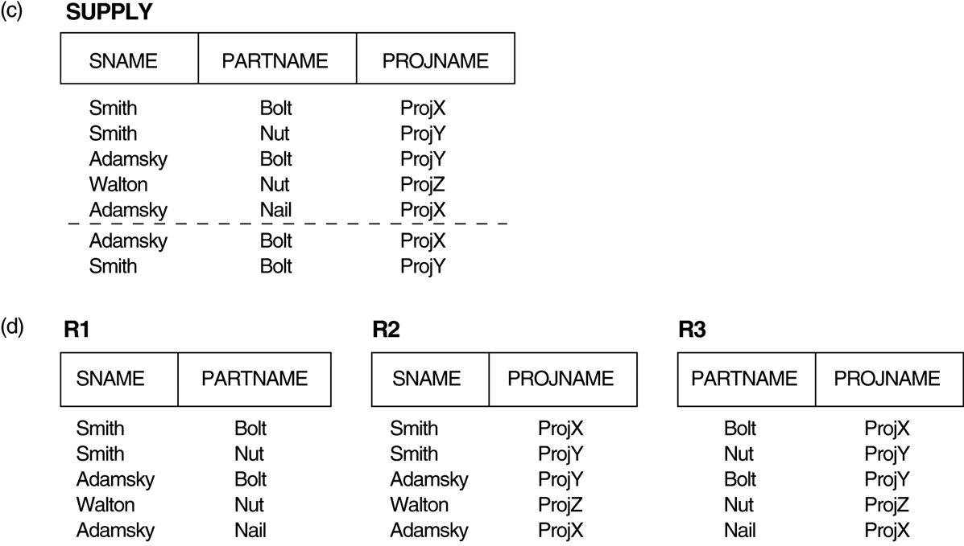
3. Multivalued Dependencies and Fourth Normal Form (1)
(c) The relation SUPPLY with no MVDs is in 4NF but not in 5NF if it has the JD(R1, R2, R3). (d) Decomposing the relation SUPPLY into the 5NF relations R1, R2, and R3.

Slide 19
Multivalued Dependencies and Fourth Normal Form (6)
Lossless (Non-additive) Join Decomposition into 4NF Relations:
PROPERTY LJ1’
The relation schemas R₁ and R₂ form a lossless (non-additive) join decomposition of R with respect to a set F of functional and multivalued dependencies if and only if
(R₁ ∩ R₂) —>> (R₁ - R₂)
or by symmetry, if and only if
(R₁ ∩ R₂) —>> (R₂ - R₁)).

Slide 20
Multivalued Dependencies and Fourth Normal Form (7)
Algorithm 11.5: Relational decomposition into 4NF relations with non-additive join property
Input: A universal relation R and a set of functional and multivalued dependencies F.
Set D := { R };
While there is a relation schema Q in D that is not in 4NF do {
choose a relation schema Q in D that is not in 4NF;
find a nontrivial MVD X —>> Y in Q that violates 4NF;
replace Q in D by two relation schemas (Q - Y) and (X υ Y);
};

Slide 21
4. Join Dependencies and Fifth Normal Form (1)
Definition:
A join dependency (JD), denoted by JD(R₁, R₂, ..., R_{n}), specified on relation schema R, specifies a constraint on the states r of R.
The constraint states that every legal state r of R should have a non-additive join decomposition into R₁, R₂, ..., R_{n}; that is, for every such r we have
* (π_{R1}(r), π_{R2}(r), ..., π_{Rn}(r)) = r
Note: an MVD is a special case of a JD where n = 2.
A join dependency JD(R₁, R₂, ..., R_{n}), specified on relation schema R, is a trivial JD if one of the relation schemas R_{i} in JD(R₁, R₂, ..., R_{n}) is equal to R.

Slide 22
Join Dependencies and Fifth Normal Form (2)
Definition:
A relation schema R is in fifth normal form (5NF) (or Project-Join Normal Form (PJNF)) with respect to a set F of functional, multivalued, and join dependencies if,
for every nontrivial join dependency JD(R₁, R₂, ..., R_{n}) in F⁺ (that is, implied by F),
every R_{i} is a superkey of R.

Slide 23
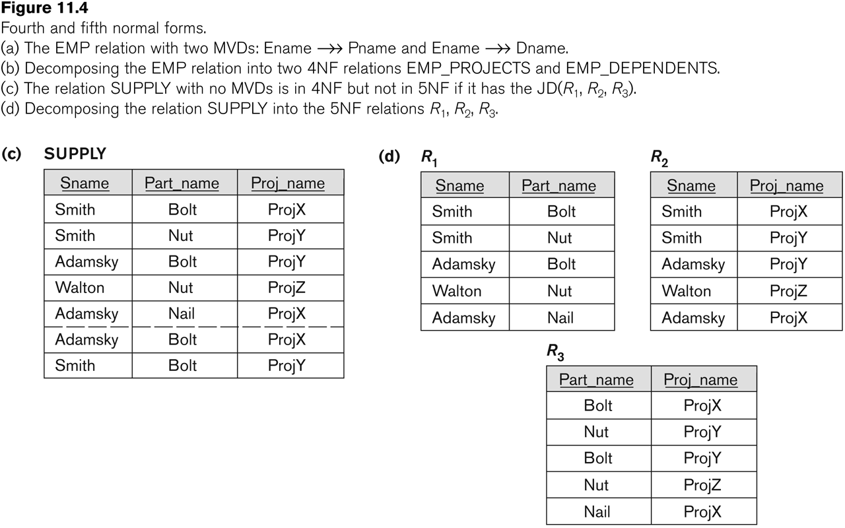
Relation SUPPLY with Join Dependency and conversion to Fifth Normal Form

